Slide 1
AI-Driven Diesel Supply Chain Disruption Predictor and Inventory Optimization System
Presented By
Deepak T

Slide 2
Introduction
Overview:
Diesel supply chains are critical for transportation and industrial operations.
Unexpected disruptions can lead to severe financial losses and operational delays.
Leveraging AI can help businesses predict supply chain risks and take proactive measures.

Slide 3
Problem Statement
Challenges in Diesel Supply Chain Management:
Frequent supply disruptions due to geopolitical issues, natural disasters, or logistics failures.
Lack of real-time visibility and risk assessment.
Inefficient inventory management leading to stock shortages or surplus.

Slide 4
Project Objectives
Key Goals:
Develop an AI-powered system to monitor and analyze global diesel supply chain risks.
Predict disruptions using Groq API and DistilBERT-based sentiment analysis.
Provide real-time alerts and insights through Slack notifications and Streamlit dashboard.
Optimize inventory levels dynamically to prevent shortages or overstocking.

Slide 5
Technologies Used
Groq API – Risk analysis from global diesel supply chain news.
DistilBERT – Sentiment analysis for market trends.
NewsAPI – Fetches relevant supply chain updates.
Streamlit – Interactive dashboard for real-time monitoring.
Slack Notifications – Alerts for low inventory and high-risk scenarios.

Slide 6
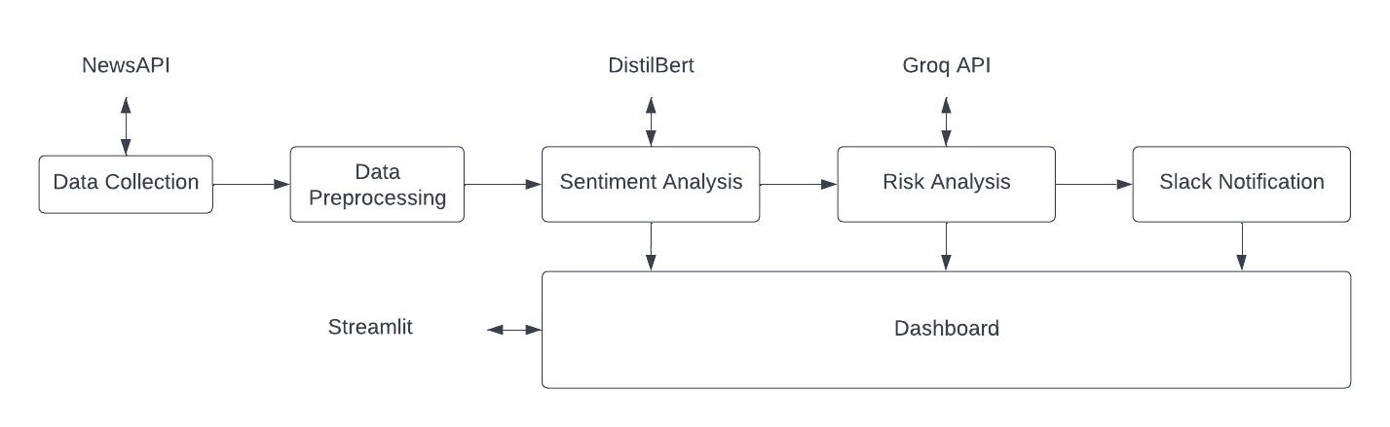
System Architecture

Slide 7
Modules Implemented
Global Diesel Data Monitoring – News-based risk detection.
Predictive Disruption Modeling – AI-generated risk scores.
Inventory Adjustment & Optimization – Automated reorder recommendations.
Slack Alerts & Dashboard – Real-time notifications and interactive data visualization.

Slide 8
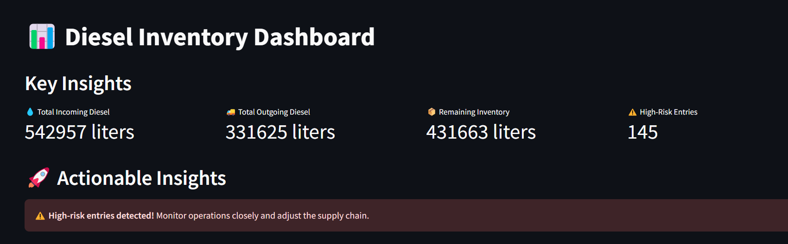
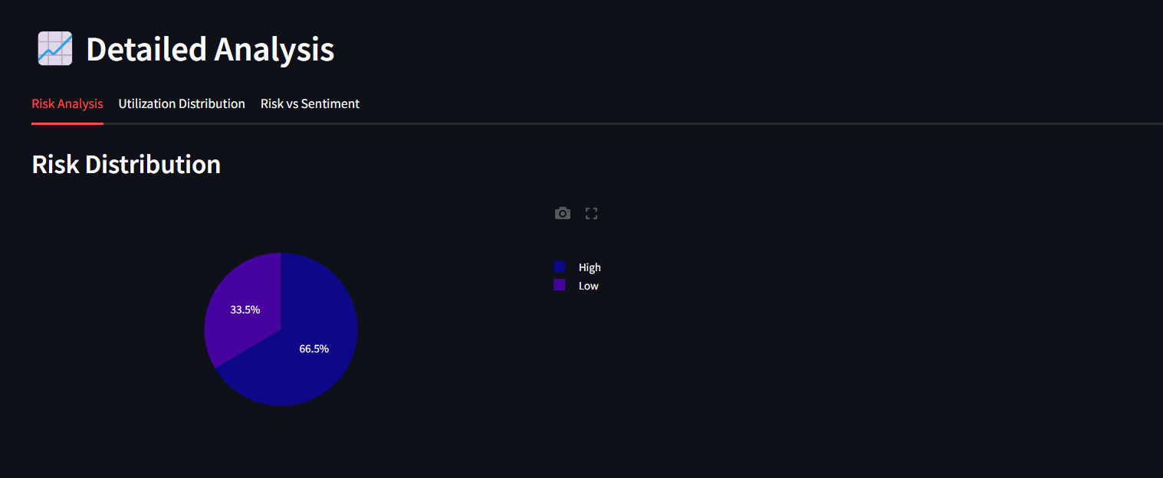
Snapshots

Slide 9
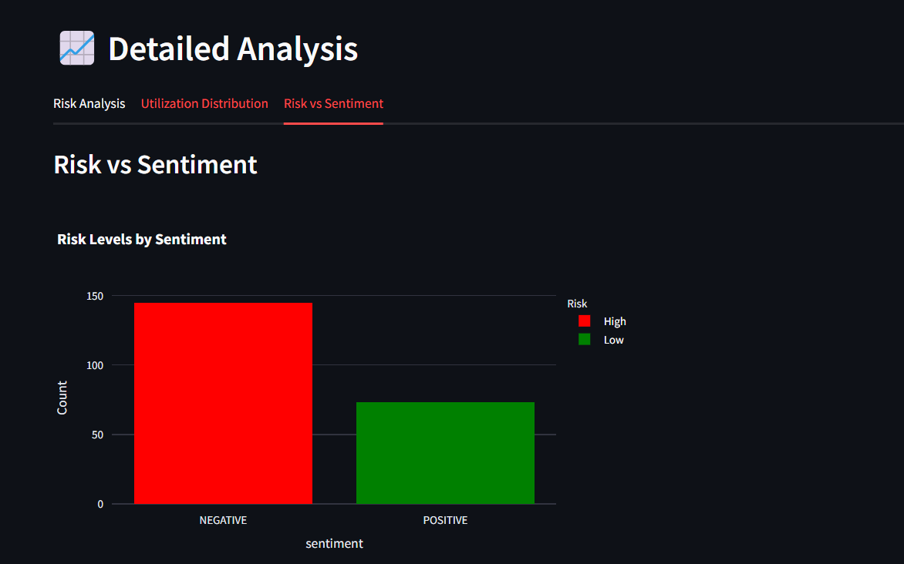
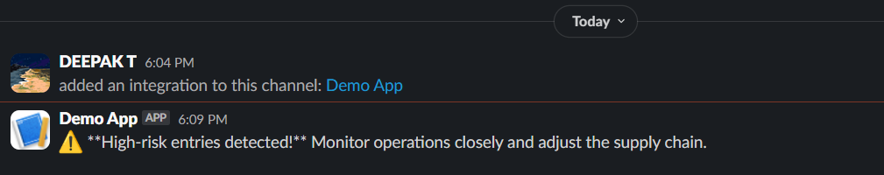
Snapshots

Slide 10
Challenges & Future Enhancements
Challenges Faced:
Handling large datasets efficiently.
Improving risk model accuracy.
Expanding ERP integration for inventory adjustments.
Future Enhancements:
Adding social media & weather data for better risk prediction.
Enhancing real-time anomaly detection.
Implementing reinforcement learning for smarter diesel inventory decisions.

Slide 11
THANK YOU

